Slide 1
Pointers and Arrays
Course Leader:
Jishmi Jos Choondal

Slide 2
Objectives
At the end of this lecture, student will be able to
apply the concept of pointers and arrays in C programming language

Slide 3
Contents
Arrays and functions
Pointers and arrays
Parameter passing mechanism

Slide 4
Arrays and Functions
Name of array is constant storing the address of first element
Function prototype
void myFunction(int [], int);
Function definition
void myFunction(int myArray[], int myArraySize){
…
}

Slide 5
Arrays and Functions contd.
C automatically passes arrays to functions by reference
Passing arrays
Specify array name without brackets
int myArray[32];
myFunction(myArray,32);
Array size usually passed to function, unlike char array no special terminator
Passing array elements
Subscripted name in function call
myFunction(myArray[10]);

Slide 6
Pointers and Arrays
The address of the first element of the array can be written as &array[0] or array
Address of the second element can be written as &array[1]
Generally, address of i^{th} elements is &array[i-1] or (array+(i-1))
The value at the address [(array+i)] is referenced by *(array+i) which is equivalent to array[i]
*(p+5) equivalent to p[5]

Slide 7
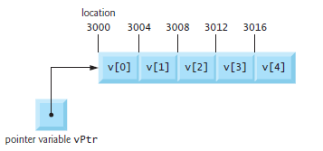
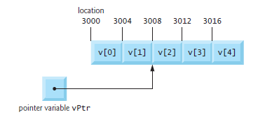
Pointers and Arrays contd.
Variable vPtr can be initialized to point to array
vPtr = v; or vPtr = &v[0];
vPtr += 2;
would produce 3008 (3000 + 2 * 4), assuming an integer is stored in 4 bytes of memory
What is vPtr -= 4;

Slide 8
Pointers to Arrays
A pointer variable can be used to access the elements of an array of the same type
int gradeList[8] = {92,85,75,88,79,54,34,96};
int *myGrades = gradeList;
printf(“%d”, gradeList[1]);
printf(“%d”, *myGrades);
printf(“%d”, *(myGrades + 2));
printf(“%d”, myGrades[3]);

Slide 9
Multidimensional Arrays
Use arrays of pointers for variable-sized multidimensional arrays
You need to allocate space for and initialize the arrays of pointers
int ***a;
a[3][5][4] expands to *(*(*(a+3)+5)+4)
int ***a
The value
int **
int *
int

Slide 10
Pointers and Strings
String Declaration
A variable of type char *
char *colPtr = "blue"; //creates pointer variable colorPtr that points to the string "blue" somewhere in memory
A string is accessed via a pointer to the first character in the string
The value of a string is the address of its first character
A string is a pointer
A pointer to the string’s first character

Slide 11
Pointers and Strings - Example
Using pointers to access the array elements
char name[]="MSRUAS";
char *ptr;
ptr=name;
while(*ptr!='\0'){
printf("%c ",*ptr);
ptr++;
}

Slide 12
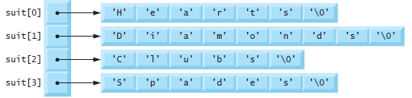
Arrays of Pointers
Arrays may contain pointers
A common use of an array of pointers is to form an array of strings
const char *suit[ 4 ] = { "Hearts", "Diamonds", "Clubs", "Spades" };
The char * portion of the declaration indicates that each element of array suit is of type “pointer to char.”
Qualifier const indicates that the strings pointed to by each element pointer will not be modified

Slide 13
Pointers to Functions
A function, like a variable has an address location in the memory
It is possible to declare a pointer to a function, which can then be used as an argument in another function
A pointer to a function is declared as follows:
type (*fptr)( );
This tells the compiler that fptr is a pointer to a function which returns type value

Slide 14
Parameter Passing Mechanisms
Arguments are generally passed to functions in one of the two ways
Call by value
Sending values of the arguments
Value is copied from argument list to parameters
Changes in function do not effect original variables
Call by reference
Sending the address of the arguments
Passes original argument’s address
Changes in function effect original variable

Slide 15
Call by Value
Call by Reference
int main(int argc, char** argv) {
int x=10;
printf("Value of x is %d",x);
displays(x);
printf("\nNew Value of x is %d",x);
return (EXIT_SUCCESS);
}
void displays(int y){
y=20;
}
int main(int argc, char** argv) {
int x=10;
printf("Value of x is %d",x);
displays(&x);
printf("\nNew Value of x is %d",x);
return (EXIT_SUCCESS);
}
void displays(int *y){
*y=20;
}

Slide 16
Summary
A pointer variable can be used to access the elements of an array of the same type
Arrays may contain pointers
A string is accessed via a pointer to the first character in the string
Arguments are generally passed to functions in one of the two ways – Call by value and call by reference

Slide 17
Further Reading
Kernighan, B. W. and Richie, D. (1992) The C Programming Language. 2nd ed., New Delhi:PHI.

